Slide 1
So you're interested in creating
an inclusive workplace...
this PowerPoint is designed to help you get buy in from key stakeholders within your organization.
Employer Resource
Illustration by Freepik

Slide 2
Who are the key stakeholders, you wonder?
We recommend beginning by connecting with either the Diversity, Equity, and Inclusion (DEI) team or the HR recruitment department. In the event that your company doesn't have these specific roles, why not have a chat with your manager? And if you happen to have a direct line to someone in the C-suite, consider them your prime choice for engagement!
This document is intended to provide best practices informed by research, subject expertise, and input from neurodivergent professionals. It does not contain official legal or HR advice.
Illustration by Freepik

Slide 3
There are parts of this PowerPoint presentation that are
highlighted in GREEN.
This indicates an instruction for you as the presenter when adapting this deck for your organization.

Slide 4
There are also parts of this PowerPoint presentation that are
highlighted in YELLOW.
This indicates places where you will need to add information that is specific to your organization.

Slide 5
Introduction/Overview:
Our company’s values
Our company’s goals
Where we stand
Neurodiversity: An opportunity to propel us forward
REPLACE WITH
YOUR LOGO ON THIS AND THE FOLLOWING SLIDES
CHANGE TO MATCH YOUR BRAND’S COLOR(S) ON THIS AND THE FOLLOWING SLIDES

Slide 6
CHANGE BACKGROUND COLOR TO MATCH YOUR BRAND’S COLOR(S)
Organizations like JP Morgan Chase, SAP, EY, & more are embracing neurodiversity in the workplace – changing their processes to be more inclusive of employees with autism, ADHD, dyslexia, and other differences – and they’re seeing the business benefit.
X Company can be next.

Slide 7
X Company’s Goals
Attract & retain qualified employees
Reduce turn over
Improve overall employee morale
Increase innovation
Improve productivity
Achieve DEI & ESG Goals
Above is a list of common goals. We suggest you update this list to reflect the actual goals of your organization.
Illustration by Freepik

Slide 8
This graph is editable – note if you do not have access to retention data, we recommend removing this slide.
The Numbers

Slide 9
A Simple Solution
Neurodiversity at work – simple changes in business practices and culture that make X Company more accessible to neurodiverse employees.
Illustration by Freepik

Slide 10
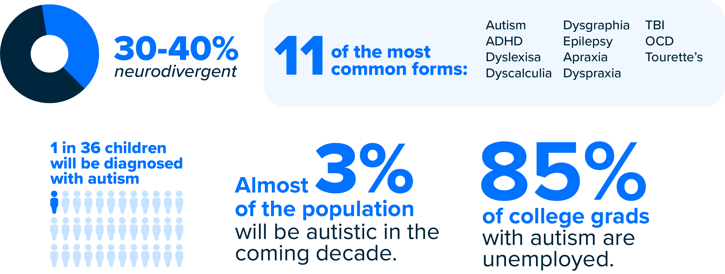
What is Neurodiversity?
Neurodiversity describes the idea that people experience and interact with the world around them in many different ways; there is no one "right" way of thinking, learning, and behaving, and differences are not viewed as deficits. - Harvard Business Journal

Slide 11
How neuro-inclusion benefits the organization:
Return on investment
Neurodiversity at work programs are NOT for PR (while this is true, there are are also PR benefits – like neurodivergent talent wanting to come to your organization, attracting talent who cares about inclusivity, etc.), inclusive workplaces have proven benefits including:
Increased productivity and efficiency
Reduced turnover and the costs related to this
Improved customer satisfaction and loyalty
Improved innovation
Employee engagement
Cultivation of neurodivergent strengths to benefit the workplace
Increased profitability
Illustration by Freepik

Slide 12
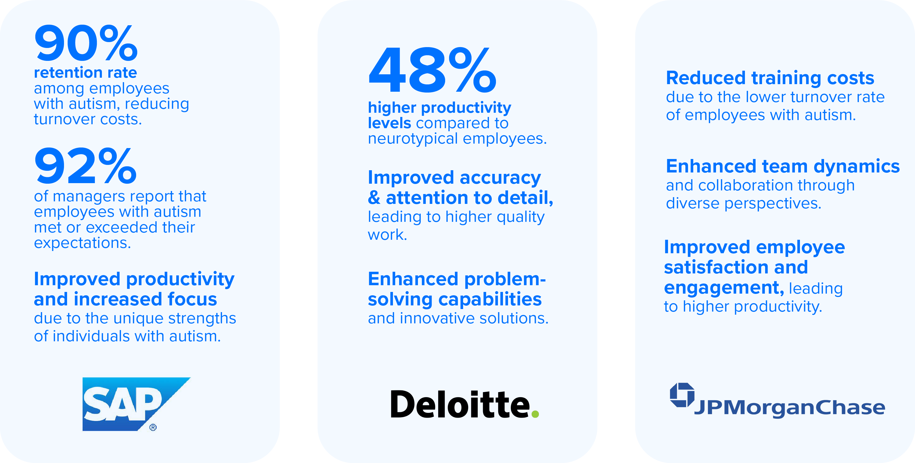
Neurodiversity at Work Successes

Slide 13
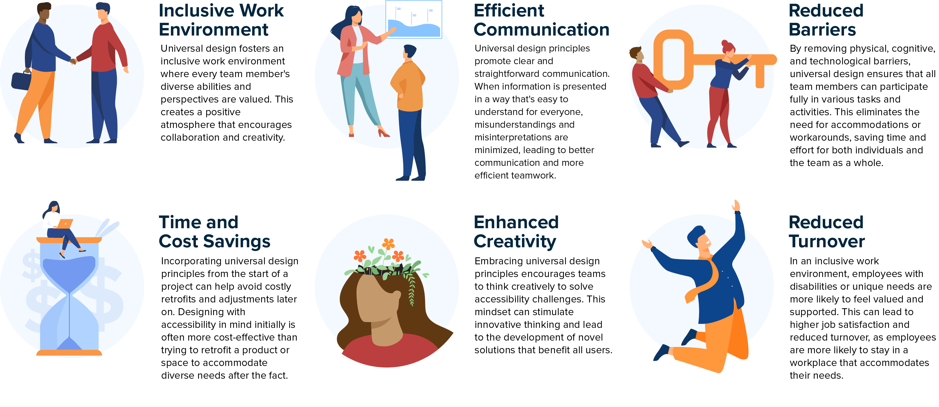
How? Neuroinclusive Universal Design:
Implementing a neurodiverse-friendly work environment is low cost AND often provides benefits to neurotypical members on the team too... this is called Universal Design.
Illustrations by Freepik

Slide 14
Inclusive Work Environment
Developing and maintain an inclusive work environment is good for all employees.
How we can ensure an inclusive environment:
Implement training programs tailored to individual needs
Create sensory-friendly workspaces
Emphasize clear communication and expectations
Create mentoring and support networks
Embrace flexible work arrangements
Illustration by Freepik

Slide 15
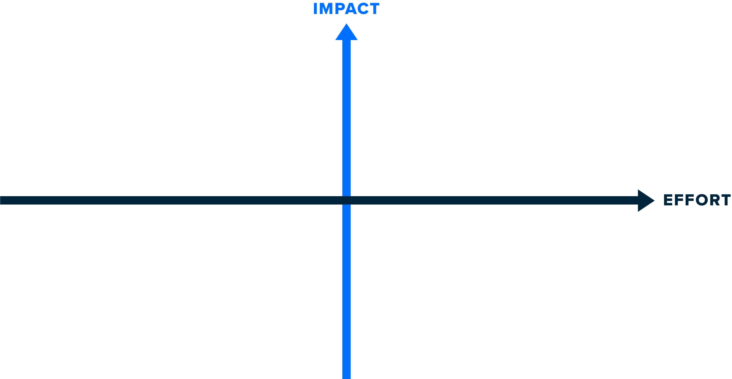
Where to Begin
Create a Neuro-inclusive Employee Resource Group
Implement NEXT Connects mentorship program to steward neurodiverse college students into their future careers
Review induction, learning & development packages to incorporate different leaning styles​
Incorporate neuro-inclusive job boards into HR posting list
Coaching for internal candidates who are applying for a different role or a promotion
Implement this interview support protocol to all potential hires
Train all staff on neuro-inclusive practices
Monthly diversity emails highlighting different neurodiverse conditions
Examine recruitment practices to ensure inclusivity
Survey employees about disability and publish those statistics in DEI reporting​
Add an accommodations statement to all job postings
Set up learning and awareness events and use communication channels including social media
Ask all new hires what accommodations will make them most productive in the work place

Slide 16
Next Steps
How to start:
Develop measurable goals for implementation
Create a budget
Identify a department, manager, or other leader open to trying concept
Select actions
Implement
Assess success, iterate
Illustration by Freepik

Slide 17
Actionable Ideas
Choose 1-3 ideas that you would like to implement this year (do not present this whole list to management).
DATE: Partner with Marketing and HR to distribute monthly diversity emails highlighting different neurodiverse conditions, their strengths and how to best support them
DATE: Incorporate one of these neuro-inclusive job boards into our company's posting
DATE: Train all staff on neuro-inclusive practices (link to NEXT training)
DATE: Create a Neuro-inclusive ERG
DATE: Add an accommodations statement to all job postings (link to template)
DATE: Ask all new hires what accommodations will make them most productive in the work place
DATE: Implement this interview support protocol to all potential hires. (link)
DATE: Examine recruitment practices to ensure inclusivity (link to NEXT job posting assessment)
DATE: Coaching for internal candidates who are applying for a different role or a promotion
DATE: Set up learning and awareness events and use communication channels including social media
DATE : Review induction, learning & development packages to incorporate different leaning styles
DATE: Implement NEXT Connects mentorship program to steward neurodiverse college students into their future careers (link to NEXT Connects)
DATE: Survey employees about disability and publish those statistics in DEI reporting.
Hire # of neurodiverse candidates by DATE.
We are always seeking improvement in our pursuit of disability inclusion. Please provide your feedback here.

Slide 18
Conclusions
Illustration by Freepik
Neuro-inclusion aligns with our organization’s values.
Neuro-inclusion makes good business sense.
X Company can be a part of the neuro-inclusion movement with your buy-in.

Slide 19
References
Autism Europe (2014), Autism and Work - Together we can: A report on good practices in employment for people with autism from across Europe, by Nikki Sullings and Aurélie Baranger, http://www.autismeurope.org
Chen, J.L. et al. (2015), “Trends in employment for individuals with autism spectrum disorder: A review of the research literature”, Review Journal of Autism Development Disorder, Vol. 2, pp. 115–127.
Henley, D. (2022, March 22). The secret to creating a sense of belonging at work. Forbes. Retrieved from https://www.forbes.com/sites/ dedehenley/2022/03/20/the-secret-to-creating-a-sense-of-belonging-at-work/?sh=5ed3e4647a88
House of Commons Work and Pensions Committee. (2016-2017). Disability employment gap. Publications.parliament.uk. https://publications.parliament.uk/pa/cm201617/cmselect/cmworpen/56/56.pdf
OECD/European Union (2017), “Specialisterne & SAP: A partnership for access to markets, multiple countries/ Denmark”, in Boosting Social Enterprise Development: Good Practice Compendium, OECD Publishing, Paris.
The Future of Diversity, Equity, Inclusion and Belonging 2023. Accessed from HR.com, sponsored by Affinity. Retrieved from https://www.affirmity.com/wpcontent/uploads/2023/03/Future_of_Diversity_Equity_Inclusion_and_Belonging_2023_ResearchReport_HRcom_Affirmity.pdf

